Slide 1
Organic Waste
Smart Waste Management For Smarter Cluster Schools

Slide 2
What is biodegradable ?
Biodegradable waste is organic material that can be broken into carbon dioxide, methane or simple organic molecules

Slide 3
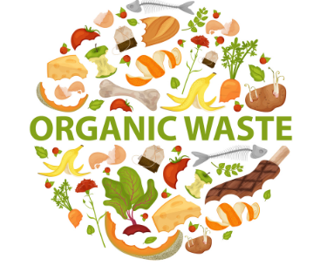
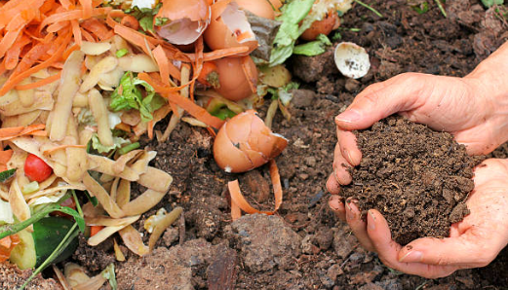
What is organic waste ?
Organic waste is any material that is biodegradable and comes from either a plant or an animal

Slide 4
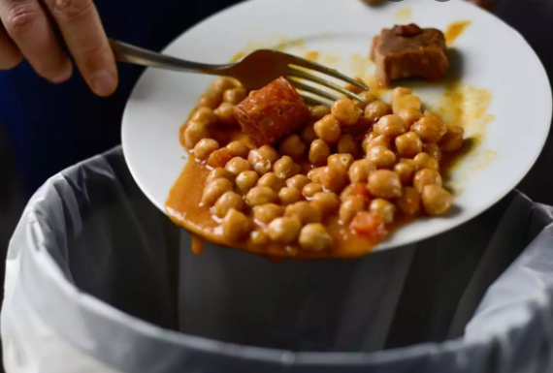
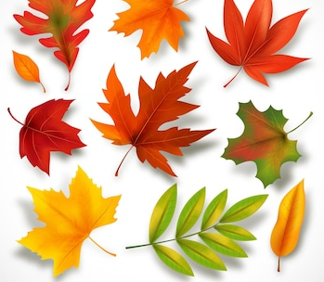
Examples of organic waste include:
Leftover food.
Fallen leaves

Slide 5
Examples of organic waste include:
Cut flowers
Pet food

Slide 6
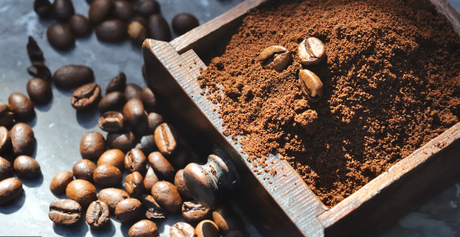
Examples of organic waste include:
Coffee grounds
Apple cores

Slide 7
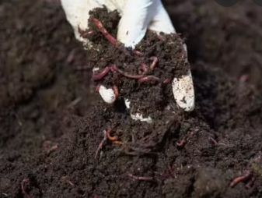
What is compost ? Your trash, Nature’s Treasure !
Green waste, also known as "biological waste", is any organic waste that can be composted such as grass or leaves, and kitchen wastes. Green wastes contain high nitrogen.
Green waste does not include things such as dried leaves, pine straw, or hay. Such materials are rich in carbon and considered "brown wastes"
Actually composting at home is much more easier than people think but because of some reasons such as bad smell, people are unwilling to do it.
Scientists found out that for thousand of years , the worms are the incredible solution that have been managing that on the quiet. Because they have the ability to compost organic materials naturally.
Compost is a mixture of ingredients used as plant fertilizer and improve soil physical, chemical and biological properties
To understand what composting is, you should keep those in mind.
Green waste
Brown waste

Slide 8
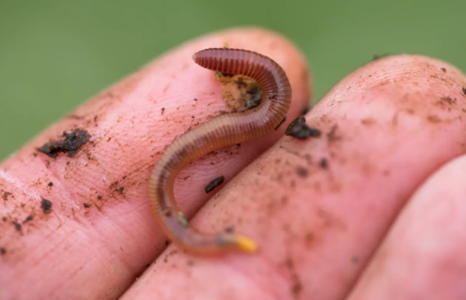
Composting all over the world
As a result of these determinations, the State of California organized campaigns to encourage the production of vermicompost ( worm humus / worm manure ) at home by distributing a compost box to each house and Red California Worm known in the world for this project.
Today, all over the world, especially in America, Canada and European countries, Domestic Organic Wastes are evaluated with the help of Compost Boxes and worms

Slide 9
Why should we compost or use organic waste as fertilizer ?
Increases the yield of vegetables by 35-40%.
Strengthens the plant root and stem.
Increases flavor and taste.
Plants have high vitamin value.

Slide 10
Thanks for listening.

